Slide 1

MACHINE LEARNING MODEL FOR CUSTOMER CHURN PREDICTION
Name: B. Manohar
Reg No: 12100789
Roll No: 04

Slide 2
Introduction
Customer Churn is common issue prevailing in service sector. This issue is highly faced by credit card companies, cable services, telecom services etc. The customer churn metrics aid in the improvement of customer retention.
To predict customer churn in banking, companies typically collect and analyze large amounts of customer data, such as credit score, balance, usage patterns, customer demographics, and loans. The data is then used to build predictive models that can identify customers who are at risk of leaving the service.

Slide 3





To predict the customer churn among Telecom industry
Estimating optimal machine learning model for customer churn
Aim
Usage of machine learning models to build, evaluate and predict the customer churn
Framing out key variables used for churn prediction

Slide 4
Abstract
Customer churn, the loss of customers to competitors or discontinuation of service, is a significant challenge for banks. Retaining existing customers is considerably cheaper than acquiring new ones, highlighting the importance of churn prediction. This project investigates customer churn prediction in the banking sector using machine learning techniques.
Through analysis of customer data, including demographics, account information, credit history, and customer service interactions, the project aims to identify key factors associated with customer churn. This will allow banks to develop targeted interventions and retention strategies to address customer dissatisfaction and ultimately reduce churn rates.
This project not only identifies key churn factors but also explores the potential for customer segmentation. By segmenting customers based on their churn risk and unique needs, banks can tailor retention efforts for maximum impact. For instance, high-risk customers might benefit from personalized incentives or proactive outreach, while low-risk customers could receive targeted marketing campaigns for new products or services.

Slide 5
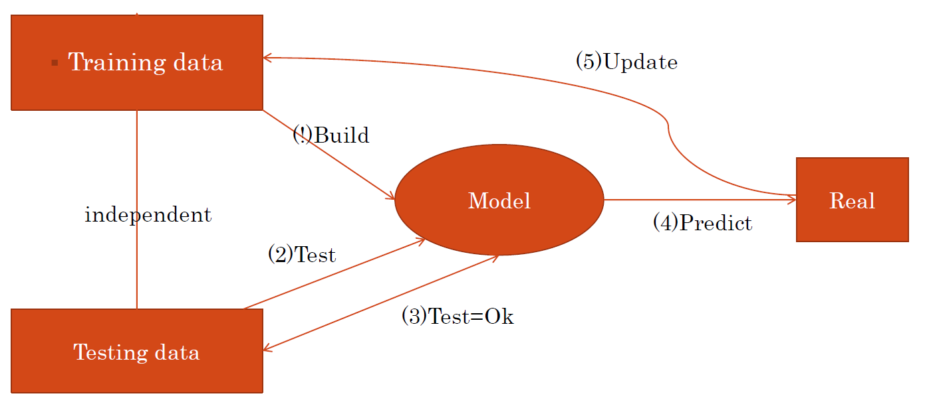
Churn Prediction Model

Slide 6
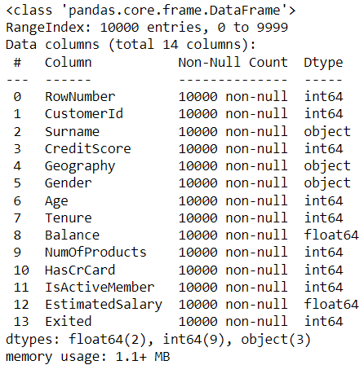
Dataset Description
The source dataset is basically a comma separated variable.
There are total 13 columns in the Dataset

Slide 7
Exploratory data analysis (EDA) method was used in this study to analyze the data.
Customer was the control variable
Model building which includes defining the purpose if model, determine the model boundary, build the model, create an interface and export the model.
Evaluating machine learning algorithm is an essential part of project.
Methods

Slide 8
The data was analyzed using python software
The libraries used are
Numpy, pandas, plotly, matplotlib, seaborn, sklearn.
Exploratory data analysis (EDA) is an approach to analyse data sets & to summarize their main characteristics, often with visual methods.
A Statistical model can be used or not, but primarily EDA is for seeing what the data can tell us beyond the formal modelling or hypothesis
Methods

Slide 9
Accuracy of Various Models
Models | Accuracy
Random Forest Classifier | 87%
Logistic Regression | 80%
Decision Tree Classifier | 90%
KNN | 77%
SVM | 78%
Naive Bayes Classifier | 79%

Slide 10
Recommendation
Offering better service for the customers
Regular collection of feedback and surveys with the customer will reduce the churn
While taking the any change in plans, it is better to conduct a customer survey, to just predict the positive and negative share of that plan. If it is negative, it is best not to implement.

Slide 11
Conclusion
The importance of this type of research in the telecom market is to help companies make more profit.
It has become known that predicting churn is one of the most important for Banking Sectors.
Hence, this research aimed to build a system that predicts the churn of customers i telecom company.
These prediction models need to achieve high values. To test and train the model, the sample data is divided into 80% for training and 20% for testing.

